Slide 1
Umbrella Theme Using WordPress
Under the Guidance of
Dr. Nagappa U Bhajantri
(Head Of Department CS&E)
Govt. Engineering College Chamarajanagara
Ashraf Ali S (4GE13CS002)
B K Abhijith Koushik (4GE10CS010)
Khustar Unnisa N(4GE14CS015)
Kusuma B M(4GE14CS018)

Slide 2


Slide 3

Open Source
Easy To Install
Customizable

Slide 4


Slide 5
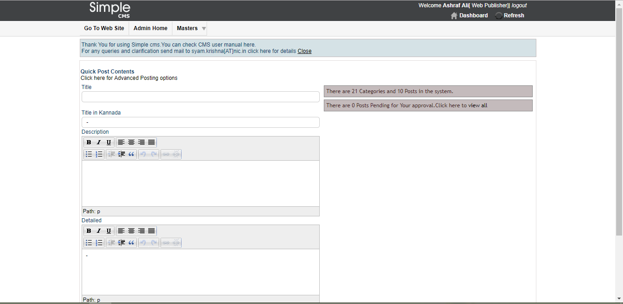

Slide 6
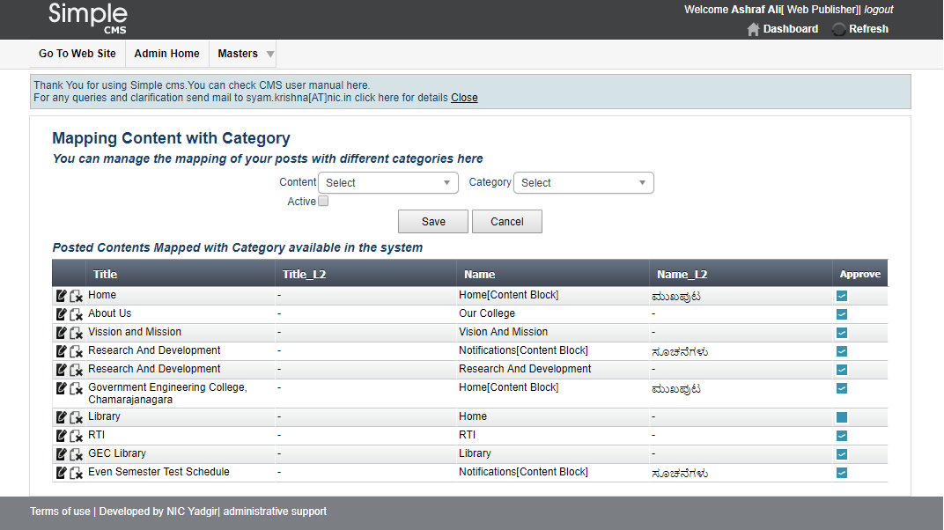
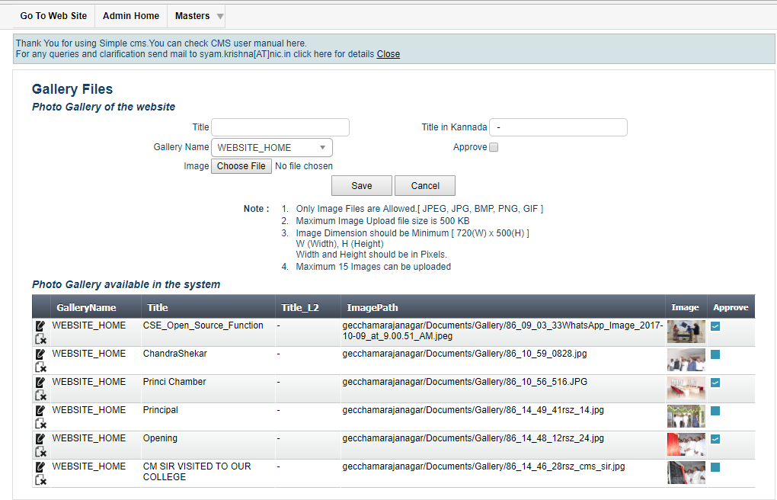
Menu Mapping
Gallery Options

Slide 7
Disadvantages of Existing System

Slide 8




Performance
Security Compromise
GUI
SEO

Slide 9


Slide 10
Student Record Management System
Faculty Record Management System
Sortable Menu Option
Separate Login For Faculty & Higher Authority
Media Management

Slide 11
Advantages of Proposed System

Slide 12
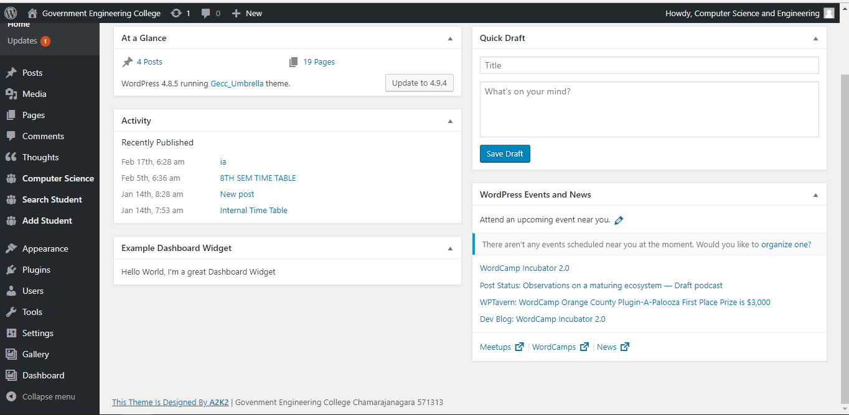

Slide 13




Performance
Security Compromise
GUI
SEO

Slide 14
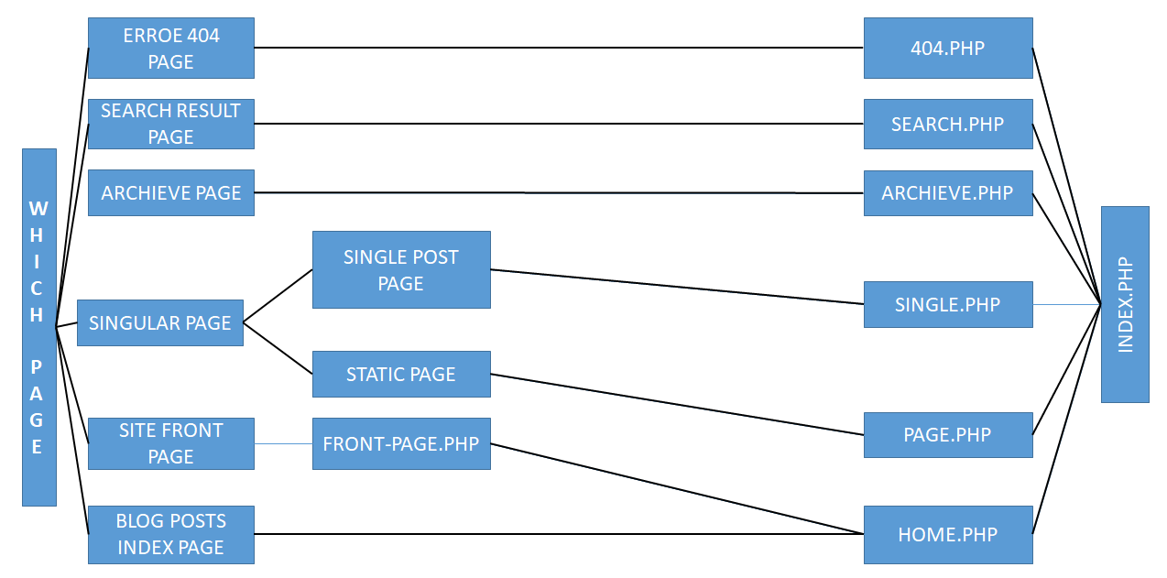
Umbrella Theme Architecture

Slide 15
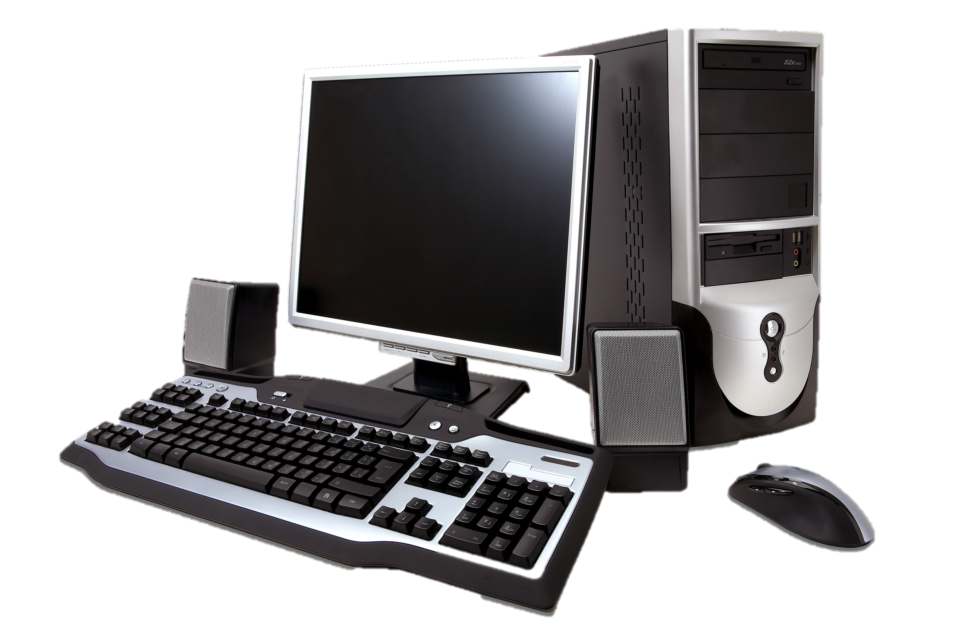
Hardware Requirements

Slide 16

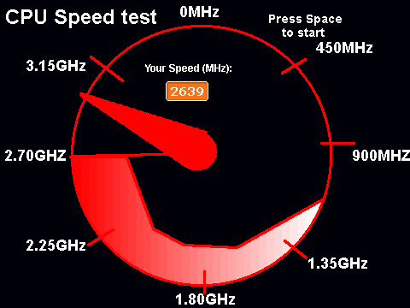
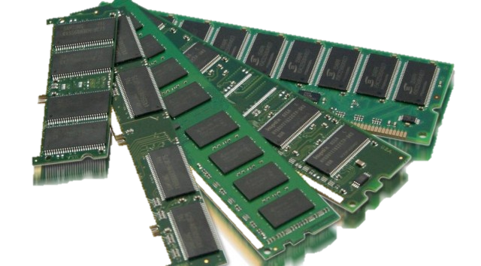
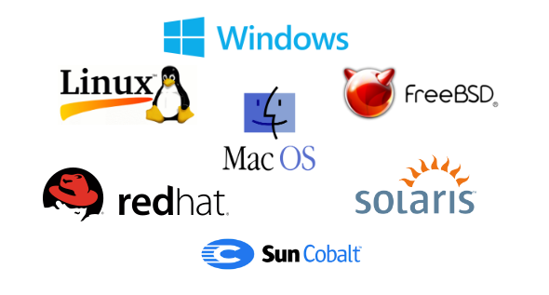
Processor
Clock Speed
RAM
Operating System

Slide 17

Software Requirements

Slide 18





Slide 19
Literature Survey
Mullenweg Matt. “WordPress Now Available”. WordPress. Retrieved 2010
“WordPress 3.5 For Beginners”, By Nico Julius, Published By WPBRIX
A. Mirdha, A. Jain, “Comparative Analysis of Open Source Content Management Systems”, IEEE int. Conf. Comput, Intell Comput, Res.

Slide 20
Thank You

